Slide 1
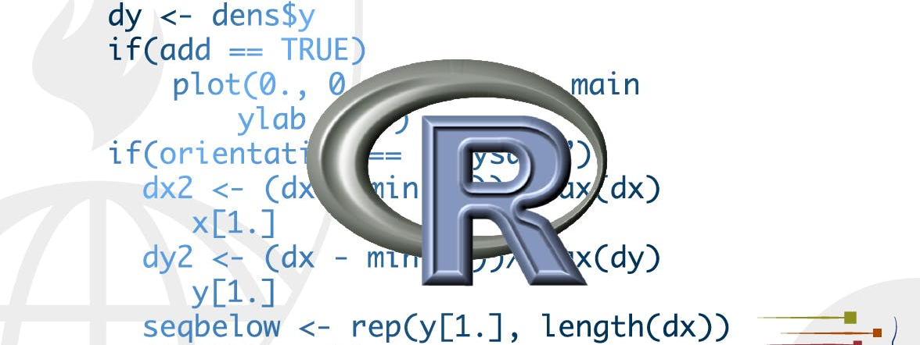
Many models
STA 4233 Introduction to Programming and Data Management in R
Notes:
In this lecture you’re going to learn three powerful ideas that help you to work with large numbers of models with ease:

Slide 2



introduction
Using many simple models to better understand complex datasets.
Using list-columns to store arbitrary data structures in a data frame.
Using the broom package, by David Robinson, to turn models into tidy data.
Notes:
Using many simple models to better understand complex datasets.
Using list-columns to store arbitrary data structures in a data frame. For example, this will allow you to have a column that contains linear models.
Using the broom package, by David Robinson, to turn models into tidy data. This is a powerful technique for working with large numbers of models because once you have tidy data, you can apply all of the techniques that you’ve learned about earlier in the course.

Slide 3

What you will learn
List-column data structure, and why it’s valid to put lists in data frames.
The three main ways in which you’ll create list-columns.
How to convert list-columns back to regular atomic vectors
About the full set of tools provided by broom, and see how they can be applied to other types of data structure.
Notes:
We’ll start by diving into a motivating example using data about life expectancy around the world. It’s a small dataset but it illustrates how important modelling can be for improving your visualisations. We’ll use a large number of simple models to partition out some of the strongest signals so we can see the subtler signals that remain. We’ll also see how model summaries can help us pick out outliers and unusual trends.
The following sections will dive into more detail about the individual techniques:
In list-columns, you’ll learn more about the list-column data structure, and why it’s valid to put lists in data frames.
In creating list-columns, you’ll learn the three main ways in which you’ll create list-columns.
In simplifying list-columns you’ll learn how to convert list-columns back to regular atomic vectors (or sets of atomic vectors) so you can work with them more easily.
In making tidy data with broom, you’ll learn about the full set of tools provided by broom, and see how they can be applied to other types of data structure.
This lecture is somewhat aspirational: if this course is your first introduction to R, this chapter is likely to be a struggle. It requires you have to deeply internalized ideas about modelling, data structures, and iteration. So don’t worry if you don’t get it — just put this chapter aside for a few months, and come back when you want to stretch your brain.
STOP Let’s talk about gapminder next

Slide 4
gapminder
library(gapminder)
gapminder
#> # A tibble: 1,704 x 6
#> country continent year lifeExp pop gdpPercap
#> <fct> <fct> <int> <dbl> <int> <dbl>
#> 1 Afghanistan Asia 1952 28.8 8425333 779.
#> 2 Afghanistan Asia 1957 30.3 9240934 821.
#> 3 Afghanistan Asia 1962 32.0 10267083 853.
#> 4 Afghanistan Asia 1967 34.0 11537966 836.
#> 5 Afghanistan Asia 1972 36.1 13079460 740.
#> 6 Afghanistan Asia 1977 38.4 14880372 786.
#> # … with 1,698 more rows
https://www.youtube.com/watch?v=jbkSRLYSojo.
Notes:
To motivate the power of many simple models, we’re going to look into the “gapminder” data. This data was popularised by Hans Rosling, a Swedish doctor and statistician. If you’ve never heard of him, stop reading this right now and go watch one of his videos! He is a fantastic data presenter and illustrates how you can use data to present a compelling story. A good place to start is this short video filmed in conjunction with the BBC: https://www.youtube.com/watch?v=jbkSRLYSojo.
The gapminder data summarises the progression of countries over time, looking at statistics like life expectancy and GDP. The data is easy to access in R, thanks to Jenny Bryan who created the gapminder package:

Slide 5
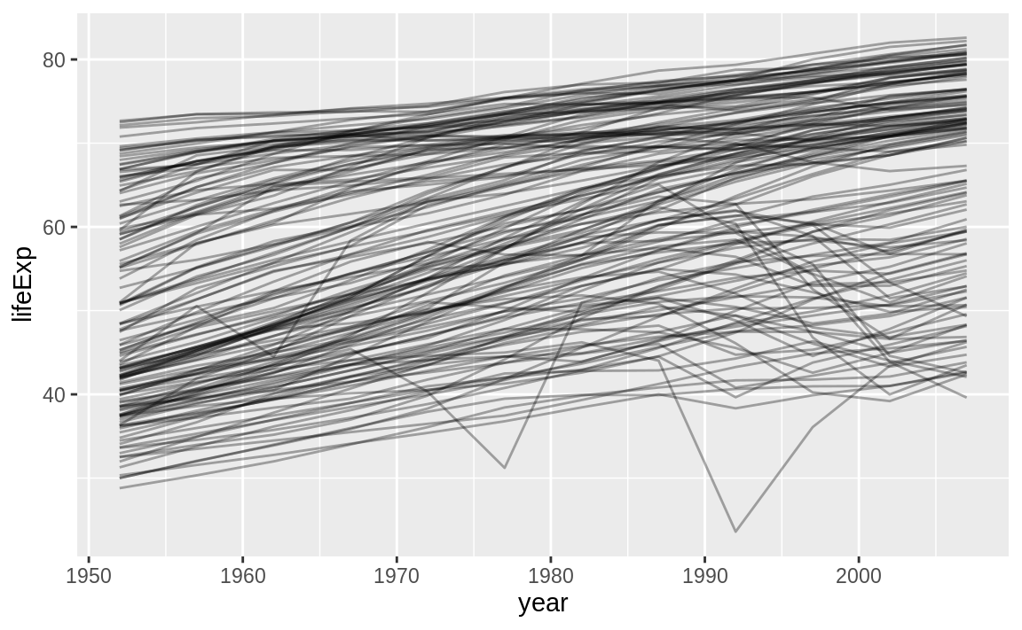
How does life expectancy change over time for each country?
gapminder %>%
ggplot(aes(year, lifeExp, group = country)) +
geom_line(alpha = 1/3)
Notes:
In this case study, we’re going to focus on just three variables to answer the question “How does life expectancy (lifeExp) change over time (year) for each country (country)?”. A good place to start is with a plot: life expectancy (lifeExp) change over time (year) for each country (country
This is a small dataset: it only has ~1,700 observations and 3 variables. But it’s still hard to see what’s going on! Overall, it looks like life expectancy has been steadily improving. However, if you look closely, you might notice some countries that don’t follow this pattern. How can we make those countries easier to see?

Slide 6
Fit a model with linear trend
us <- filter(gapminder, country == “United States")
us %>%
ggplot(aes(year, lifeExp)) +
geom_line() +
ggtitle("Full data = ")
us_mod <- lm(lifeExp ~ year, data = us)
us %>%
add_predictions(nz_mod) %>%
ggplot(aes(year, pred)) +
geom_line() +
ggtitle("Linear trend + ")
us %>%
add_residuals(us_mod) %>% ggplot(aes(year, resid)) +
geom_hline(yintercept = 0, colour = "white", size = 3) +
geom_line() +
ggtitle("Remaining pattern")
Notes:
One way is to use the same approach as in the last lecture: there’s a strong signal (overall linear growth) that makes it hard to see subtler trends. We’ll tease these factors apart by fitting a model with a linear trend. The model captures steady growth over time, and the residuals will show what’s left.
You already know how to do that if we had a single country:

Slide 7
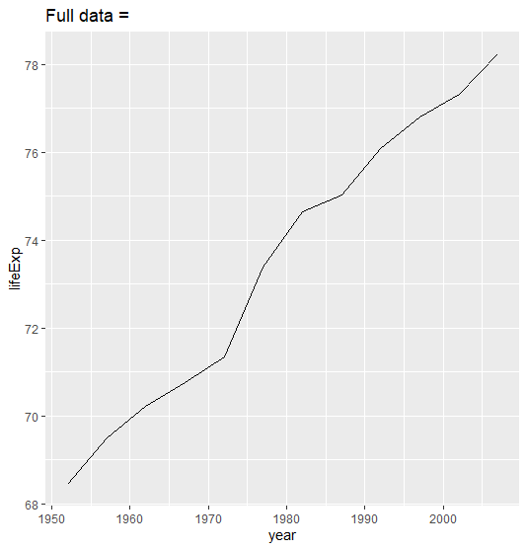
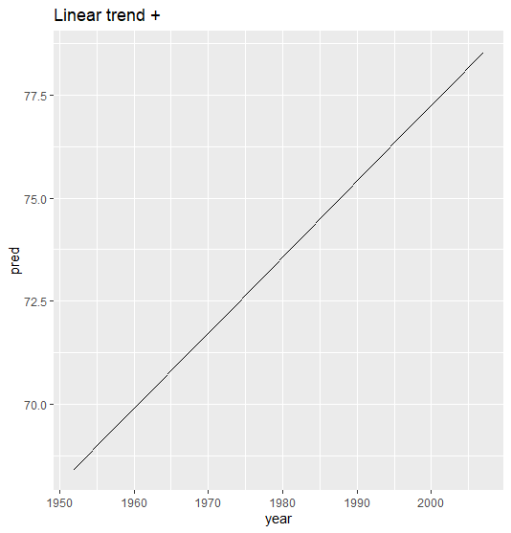
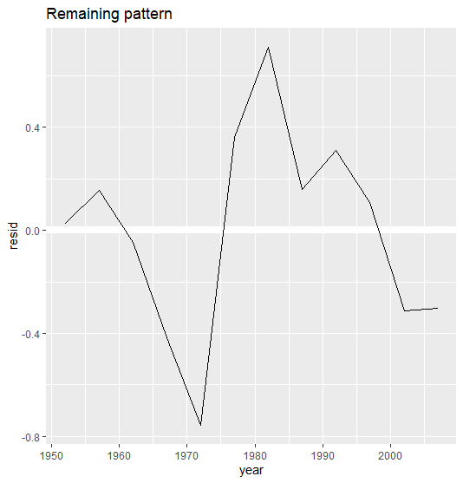
Fit a model with linear trend
Notes:
How can we easily fit that model to every country?

Slide 8
Nested data
by_country <- gapminder %>%
group_by(country, continent) %>%
nest()
by_country
#> # A tibble: 142 x 3
#> # Groups: country, continent [710]
#> country continent data
#> <fct> <fct> <list<df[,4]>>
#> 1 Afghanistan Asia [12 × 4]
#> 2 Albania Europe [12 × 4]
#> 3 Algeria Africa [12 × 4]
#> 4 Angola Africa [12 × 4]
#> 5 Argentina Americas [12 × 4]
#> 6 Australia Oceania [12 × 4]
#> # … with 136 more rows
Notes:
You could imagine copy and pasting that code multiple times; but you’ve already learned a better way! Extract out the common code with a function and repeat using a map function from purrr. This problem is structured a little differently to what you’ve seen before. Instead of repeating an action for each variable, we want to repeat an action for each country, a subset of rows. To do that, we need a new data structure: the nested data frame. To create a nested data frame we start with a grouped data frame, and “nest” it:
(I’m cheating a little by grouping on both continent and country. Given country, continent is fixed, so this doesn’t add any more groups, but it’s an easy way to carry an extra variable along for the ride.)
This creates a data frame that has one row per group (per country), and a rather unusual column: data. data is a list of data frames (or tibbles, to be precise). This seems like a crazy idea: we have a data frame with a column that is a list of other data frames! I’ll explain shortly why I think this is a good idea.

Slide 9
NESTED DATA
by_country$data[[1]]
#> # A tibble: 12 x 4
#> year lifeExp pop gdpPercap
#> <int> <dbl> <int> <dbl>
#> 1 1952 28.8 8425333 779.
#> 2 1957 30.3 9240934 821.
#> 3 1962 32.0 10267083 853.
#> 4 1967 34.0 11537966 836.
#> 5 1972 36.1 13079460 740.
#> 6 1977 38.4 14880372 786.
#> # … with 6 more rows
Notes:
The data column is a little tricky to look at because it’s a moderately complicated list, and we’re still working on good tools to explore these objects. Unfortunately using str() is not recommended as it will often produce very long output. But if you pluck out a single element from the data column you’ll see that it contains all the data for that country (in this case, Afghanistan).
Note the difference between a standard grouped data frame and a nested data frame: in a grouped data frame, each row is an observation; in a nested data frame, each row is a group. Another way to think about a nested dataset is we now have a meta-observation: a row that represents the complete time course for a country, rather than a single point in time.

Slide 10
List-columns
country_model <- function(df) {
lm(lifeExp ~ year, data = df)
}
models <- map(by_country$data, country_model)
Notes:
Now that we have our nested data frame, we’re in a good position to fit some models. We have a model-fitting function:
And we want to apply it to every data frame. The data frames are in a list, so we can use purrr::map() to apply country_model to each element:
However, rather than leaving the list of models as a free-floating object, I think it’s better to store it as a column in the by_country data frame. Storing related objects in columns is a key part of the value of data frames, and why I think list-columns are such a good idea. In the course of working with these countries, we are going to have lots of lists where we have one element per country. So why not store them all together in one data frame?

Slide 11
dplyr::mutate()
by_country <- by_country %>%
mutate(model = map(data, country_model))
by_country
#> # A tibble: 142 x 4
#> # Groups: country, continent [710]
#> country continent data model
#> <fct> <fct> <list<df[,4]>> <list>
#> 1 Afghanistan Asia [12 × 4] <lm>
#> 2 Albania Europe [12 × 4] <lm>
#> 3 Algeria Africa [12 × 4] <lm>
#> 4 Angola Africa [12 × 4] <lm>
#> 5 Argentina Americas [12 × 4] <lm>
#> 6 Australia Oceania [12 × 4] <lm>
#> # … with 136 more rows
Notes:
In other words, instead of creating a new object in the global environment, we’re going to create a new variable in the by_country data frame. That’s a job for dplyr::mutate():

Slide 12
List-columns
by_country %>%
filter(continent == "Europe")
#> # A tibble: 30 x 4
#> # Groups: country, continent [710]
#> country continent data model
#> <fct> <fct> <list<df[,4]>> <list>
#> 1 Albania Europe [12 × 4] <lm>
#> 2 Austria Europe [12 × 4] <lm>
#> 3 Belgium Europe [12 × 4] <lm>
#> 4 Bosnia and Herzegovina Europe [12 × 4] <lm>
#> 5 Bulgaria Europe [12 × 4] <lm>
#> 6 Croatia Europe [12 × 4] <lm>
#> # … with 24 more rows
Notes:
This has a big advantage: because all the related objects are stored together, you don’t need to manually keep them in sync when you filter or arrange. The semantics of the data frame takes care of that for you:

Slide 13
List-columns
by_country %>%
arrange(continent, country)
#> # A tibble: 142 x 4
#> # Groups: country, continent [710]
#> country continent data model
#> <fct> <fct> <list<df[,4]>> <list>
#> 1 Algeria Africa [12 × 4] <lm>
#> 2 Angola Africa [12 × 4] <lm>
#> 3 Benin Africa [12 × 4] <lm>
#> 4 Botswana Africa [12 × 4] <lm>
#> 5 Burkina Faso Africa [12 × 4] <lm>
#> 6 Burundi Africa [12 × 4] <lm>
#> # … with 136 more rows
Notes:
If your list of data frames and list of models were separate objects, you have to remember that whenever you re-order or subset one vector, you need to re-order or subset all the others in order to keep them in sync. If you forget, your code will continue to work, but it will give the wrong answer!

Slide 14
Unnesting
by_country <- by_country %>%
mutate(
resids = map2(data, model, add_residuals)
)
by_country
#> # A tibble: 142 x 5
#> # Groups: country, continent [710]
#> country continent data model resids
#> <fct> <fct> <list<df[,4]>> <list> <list>
#> 1 Afghanistan Asia [12 × 4] <lm> <tibble [12 × 5]>
#> 2 Albania Europe [12 × 4] <lm> <tibble [12 × 5]>
#> 3 Algeria Africa [12 × 4] <lm> <tibble [12 × 5]>
#> # … with 139 more rows
Notes:
Previously we computed the residuals of a single model with a single dataset. Now we have 142 data frames and 142 models. To compute the residuals, we need to call add_residuals() with each model-data pair:

Slide 15
Plotting a list of data frames
resids <- unnest(by_country, resids)
resids
#> # A tibble: 1,704 x 9
#> # Groups: country, continent [710]
#> country continent data model year lifeExp pop gdpPercap resid
#> <fct> <fct> <list<df[,> <lis> <int> <dbl> <int> <dbl> <dbl>
#> 1 Afghanist… Asia [12 × 4] <lm> 1952 28.8 8.43e6 779. -1.11
#> 2 Afghanist… Asia [12 × 4] <lm> 1957 30.3 9.24e6 821. -0.952
#> 3 Afghanist… Asia [12 × 4] <lm> 1962 32.0 1.03e7 853. -0.664
#> 4 Afghanist… Asia [12 × 4] <lm> 1967 34.0 1.15e7 836. -0.0172
#> 5 Afghanist… Asia [12 × 4] <lm> 1972 36.1 1.31e7 740. 0.674
#> 6 Afghanist… Asia [12 × 4] <lm> 1977 38.4 1.49e7 786. 1.65
#> # … with 1,698 more rows
Notes:
But how you can plot a list of data frames? Instead of struggling to answer that question, let’s turn the list of data frames back into a regular data frame. Previously we used nest() to turn a regular data frame into an nested data frame, and now we do the opposite with unnest():
Note that each regular column is repeated one for each row in the nested column.

Slide 16
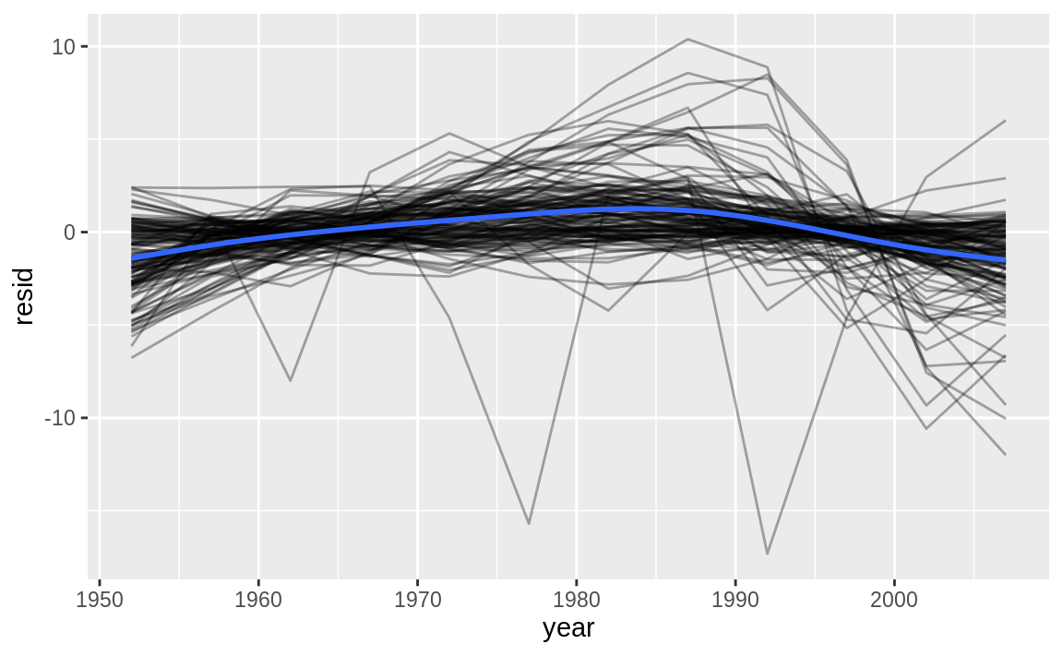
Plot residuals
resids %>%
ggplot(aes(year, resid)) +
geom_line(aes(group = country), alpha = 1 / 3) +
geom_smooth(se = FALSE)
#> `geom_smooth()` using method = 'gam' and formula 'y ~ s(x, bs = "cs")'
Notes:
Now we have regular data frame, we can plot the residuals:

Slide 17
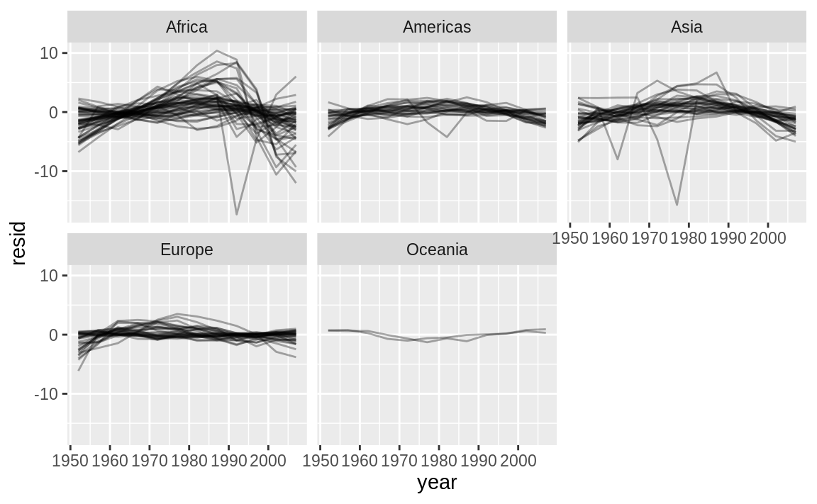
Facetting by continent
resids %>%
ggplot(aes(year, resid, group = country)) +
geom_line(alpha = 1 / 3) +
facet_wrap(~continent)
Notes:
Facetting by continent is particularly revealing:
It looks like we’ve missed some mild patterns. There’s also something interesting going on in Africa: we see some very large residuals which suggests our model isn’t fitting so well there. We’ll explore that more in the next section, attacking it from a slightly different angle.

Slide 18
Model quality
broom::glance(us_mod)
# A tibble: 1 x 11
r.squared adj.r.squared sigma statistic
<dbl> <dbl> <dbl> <dbl>
1 0.986 0.985 0.416 700.
# ... with 7 more variables: p.value <dbl>,
# df <int>, logLik <dbl>, AIC <dbl>,
# BIC <dbl>, deviance <dbl>,
# df.residual <int>
Notes:
Instead of looking at the residuals from the model, we could look at some general measurements of model quality. You learned how to compute some specific measures in the previous chapter. Here we’ll show a different approach using the broom package. The broom package provides a general set of functions to turn models into tidy data. Here we’ll use broom::glance() to extract some model quality metrics. If we apply it to a model, we get a data frame with a single row:

Slide 19
create a data frame
by_country %>%
mutate(glance = map(model, broom::glance)) %>%
unnest(glance)
#> # A tibble: 142 x 16
#> # Groups: country, continent [710]
#> country continent data model resids r.squared adj.r.squared sigma
#> <fct> <fct> <list<d> <lis> <list> <dbl> <dbl> <dbl>
#> 1 Afghan… Asia [12 × 4] <lm> <tibb… 0.948 0.942 1.22
#> 2 Albania Europe [12 × 4] <lm> <tibb… 0.911 0.902 1.98
#> 3 Algeria Africa [12 × 4] <lm> <tibb… 0.985 0.984 1.32
#> 4 Angola Africa [12 × 4] <lm> <tibb… 0.888 0.877 1.41
#> # … with 138 more rows, and 8 more variables: statistic <dbl>, p.value <dbl>,
#> # df <int>, logLik <dbl>, AIC <dbl>, BIC <dbl>, deviance <dbl>,
#> # df.residual <int>
Notes:
We can use mutate() and unnest() to create a data frame with a row for each country:
This isn’t quite the output we want, because it still includes all the list columns. This is default behaviour when unnest() works on single row data frames.

Slide 20
.drop = TRUE:
glance <- by_country %>%
mutate(glance = map(model, broom::glance)) %>%
unnest(glance, .drop = TRUE)
#> Warning: The `.drop` argument of `unnest()` is deprecated as of tidyr 1.0.0.
#> All list-columns are now preserved.
#> This warning is displayed once per session.
#> Call `lifecycle::last_warnings()` to see where this warning was generated.
glance
#> # A tibble: 142 x 16
#> # Groups: country, continent [710]
#> country continent data model resids r.squared adj.r.squared sigma
#> <fct> <fct> <list<d> <lis> <list> <dbl> <dbl> <dbl>
#> 1 Afghan… Asia [12 × 4] <lm> <tibb… 0.948 0.942 1.22
#> 2 Albania Europe [12 × 4] <lm> <tibb… 0.911 0.902 1.98
#> # … with 140 more rows, and 8 more variables: statistic <dbl>, p.value <dbl>,
#> # df <int>, logLik <dbl>, AIC <dbl>, BIC <dbl>, deviance <dbl>,
#> # df.residual <int>
Notes:
To suppress these columns we use .drop = TRUE:
(Pay attention to the variables that aren’t printed: there’s a lot of useful stuff there.)

Slide 21
Which models fit?
glance %>%
arrange(r.squared)
#> # A tibble: 142 x 16
#> # Groups: country, continent [710]
#> country continent data model resids r.squared adj.r.squared sigma
#> <fct> <fct> <list<d> <lis> <list> <dbl> <dbl> <dbl>
#> 1 Rwanda Africa [12 × 4] <lm> <tibb… 0.0172 -0.0811 6.56
#> 2 Botswa… Africa [12 × 4] <lm> <tibb… 0.0340 -0.0626 6.11
#> 3 Zimbab… Africa [12 × 4] <lm> <tibb… 0.0562 -0.0381 7.21
#> 4 Zambia Africa [12 × 4] <lm> <tibb… 0.0598 -0.0342 4.53
#> 5 Swazil… Africa [12 × 4] <lm> <tibb… 0.0682 -0.0250 6.64
#> 6 Lesotho Africa [12 × 4] <lm> <tibb… 0.0849 -0.00666 5.93
#> # … with 136 more rows, and 8 more variables: statistic <dbl>, p.value <dbl>,
#> # df <int>, logLik <dbl>, AIC <dbl>, BIC <dbl>, deviance <dbl>,
#> # df.residual <int>
Notes:
With this data frame in hand, we can start to look for models that don’t fit well:
The worst models all appear to be in Africa. Let’s double check that with a plot.

Slide 22
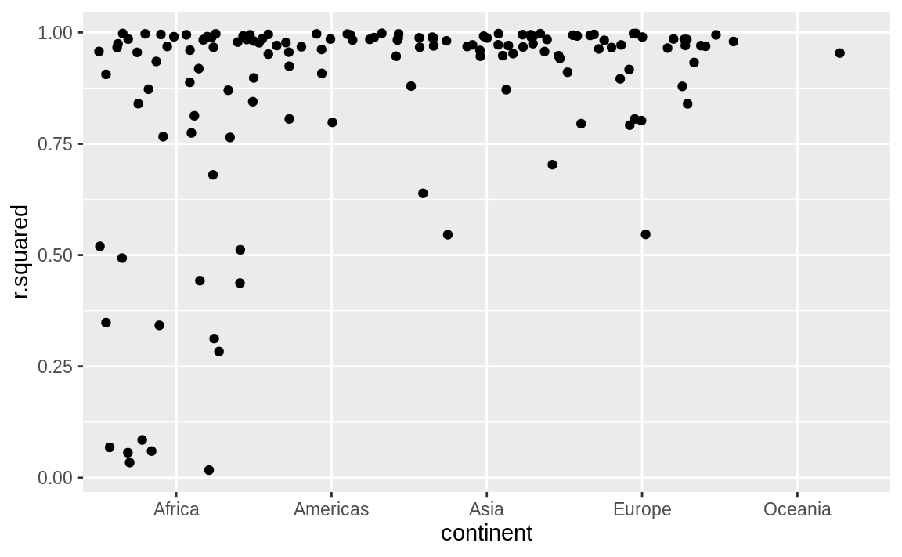
Geom_jitter()
glance %>% ggplot(aes(continent, r.squared)) + geom_jitter(width = 0.5)
Notes:
Here we have a relatively small number of observations and a discrete variable, so geom_jitter() is effective:

Slide 23
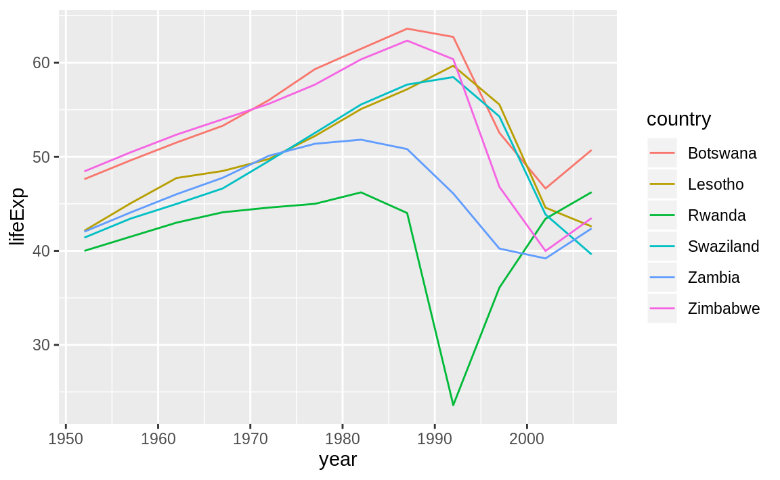
countries with bad R²
bad_fit <- filter(glance, r.squared < 0.25)
gapminder %>%
semi_join(bad_fit, by = "country") %>%
ggplot(aes(year, lifeExp, colour = country)) +
geom_line()
Notes:
We could pull out the countries with particularly bad R2R2 and plot the data:
We see two main effects here: the tragedies of the HIV/AIDS epidemic and the Rwandan genocide.

Slide 24
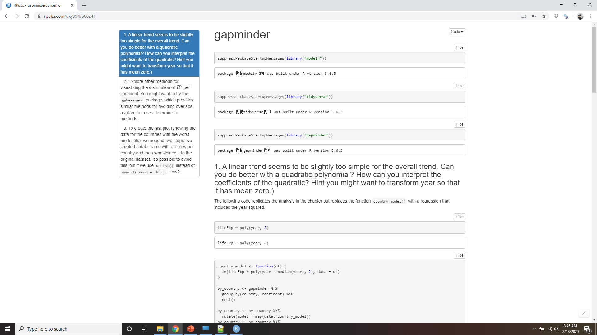
Demo gapminder
Notes:
https://rpubs.com/uky994/586241
A linear trend seems to be slightly too simple for the overall trend. Can you do better with a quadratic polynomial? How can you interpret the coefficients of the quadratic? (Hint you might want to transform year so that it has mean zero.)
Explore other methods for visualising the distribution of R2R2 per continent. You might want to try the ggbeeswarm package, which provides similar methods for avoiding overlaps as jitter, but uses deterministic methods.
To create the last plot (showing the data for the countries with the worst model fits), we needed two steps: we created a data frame with one row per country and then semi-joined it to the original dataset. It’s possible to avoid this join if we use unnest() instead of unnest(.drop = TRUE). How?

Slide 25
List-columns
data.frame(x = list(1:3, 3:5))
#> x.1.3 x.3.5
#> 1 1 3
#> 2 2 4
#> 3 3 5
data.frame(
x = I(list(1:3, 3:5)),
y = c("1, 2", "3, 4, 5")
)
#> x y
#> 1 1, 2, 3 1, 2
#> 2 3, 4, 5 3, 4, 5
Notes:
Now that you’ve seen a basic workflow for managing many models, let’s dive back into some of the details. In this section, we’ll explore the list-column data structure in a little more detail. It’s only recently that I’ve really appreciated the idea of the list-column. List-columns are implicit in the definition of the data frame: a data frame is a named list of equal length vectors. A list is a vector, so it’s always been legitimate to use a list as a column of a data frame. However, base R doesn’t make it easy to create list-columns, and data.frame() treats a list as a list of columns:.
You can prevent data.frame() from doing this with I(), but the result doesn’t print particularly well:

Slide 26
tibble(
x = list(1:3, 3:5),
y = c("1, 2", "3, 4, 5")
)
#> # A tibble: 2 x 2
#> x y
#> <list> <chr>
#> 1 <int [3]> 1, 2
#> 2 <int [3]> 3, 4, 5
tribble(
~x, ~y,
1:3, "1, 2",
3:5, "3, 4, 5"
)
#> # A tibble: 2 x 2
#> x y
#> <list> <chr>
#> 1 <int [3]> 1, 2
#> 2 <int [3]> 3, 4, 5
Notes:
Tibble alleviates this problem by being lazier (tibble() doesn’t modify its inputs) and by providing a better print method:
It’s even easier with tribble() as it can automatically work out that you need a list:
List-columns are often most useful as intermediate data structure. They’re hard to work with directly, because most R functions work with atomic vectors or data frames, but the advantage of keeping related items together in a data frame is worth a little hassle.

Slide 27
effective list-column pipeline
You create the list-column using one of nest(), summarise() + list(), or mutate() + a map function
You create other intermediate list-columns by transforming existing list columns with map(), map2() or pmap().
You simplify the list-column back down to a data frame or atomic vector
Notes:
Generally there are three parts of an effective list-column pipeline:
You create the list-column using one of nest(), summarise() + list(), or mutate() + a map function, as described in Creating list-columns.
You create other intermediate list-columns by transforming existing list columns with map(), map2() or pmap(). For example, in the case study above, we created a list-column of models by transforming a list-column of data frames.
You simplify the list-column back down to a data frame or atomic vector, as described in Simplifying list-columns.
STOP see you next time when we talk about creating list-columns

Slide 28
Creating list-columns
With tidyr::nest() to convert a grouped data frame into a nested data frame where you have list-column of data frames.
With mutate() and vectorised functions that return a list.
With summarise() and summary functions that return multiple results.
Notes:
Typically, you won’t create list-columns with tibble(). Instead, you’ll create them from regular columns, using one of three methods:
With tidyr::nest() to convert a grouped data frame into a nested data frame where you have list-column of data frames.
With mutate() and vectorised functions that return a list.
With summarise() and summary functions that return multiple results.
Alternatively, you might create them from a named list, using tibble::enframe().
Generally, when creating list-columns, you should make sure they’re homogeneous: each element should contain the same type of thing. There are no checks to make sure this is true, but if you use purrr and remember what you’ve learned about type-stable functions, you should find it happens naturally.

Slide 29
With nesting
gapminder %>%
group_by(country, continent) %>%
nest()
#> # A tibble: 142 x 3
#> # Groups: country, continent [710]
#> country continent data
#> <fct> <fct> <list<df[,4]>>
#> 1 Afghanistan Asia [12 × 4]
#> 2 Albania Europe [12 × 4]
#> 3 Algeria Africa [12 × 4]
#> 4 Angola Africa [12 × 4]
#> 5 Argentina Americas [12 × 4]
#> 6 Australia Oceania [12 × 4]
#> # … with 136 more rows
Notes:
nest() creates a nested data frame, which is a data frame with a list-column of data frames. In a nested data frame each row is a meta-observation: the other columns give variables that define the observation (like country and continent above), and the list-column of data frames gives the individual observations that make up the meta-observation.
There are two ways to use nest(). So far you’ve seen how to use it with a grouped data frame. When applied to a grouped data frame, nest() keeps the grouping columns as is, and bundles everything else into the list-column:

Slide 30
With nesting
gapminder %>%
nest(year:gdpPercap)
#> Warning: All elements of `...` must be named.
#> Did you want `data = c(year, lifeExp, pop, gdpPercap)`?
#> # A tibble: 142 x 3
#> country continent data
#> <fct> <fct> <list<df[,4]>>
#> 1 Afghanistan Asia [12 × 4]
#> 2 Albania Europe [12 × 4]
#> 3 Algeria Africa [12 × 4]
#> 4 Angola Africa [12 × 4]
#> 5 Argentina Americas [12 × 4]
#> 6 Australia Oceania [12 × 4]
#> # … with 136 more rows
Notes:
You can also use it on an ungrouped data frame, specifying which columns you want to nest:

Slide 31
From vectorised functions
df <- tribble(
~x1,
"a,b,c",
"d,e,f,g"
)
df %>%
mutate(x2 = stringr::str_split(x1, ","))
#> # A tibble: 2 x 2
#> x1 x2
#> <chr> <list>
#> 1 a,b,c <chr [3]>
#> 2 d,e,f,g <chr [4]>
Notes:
Some useful functions take an atomic vector and return a list. For example, in strings you learned about stringr::str_split() which takes a character vector and returns a list of character vectors. If you use that inside mutate, you’ll get a list-column:

Slide 32
Unest can handle
df %>%
mutate(x2 = stringr::str_split(x1, ",")) %>%
unnest()
#> Warning: `cols` is now required.
#> Please use `cols = c(x2)`
#> # A tibble: 7 x 2
#> x1 x2
#> <chr> <chr>
#> 1 a,b,c a
#> 2 a,b,c b
#> 3 a,b,c c
#> # … with 4 more row
Notes:
unnest() knows how to handle these lists of vectors:
(If you find yourself using this pattern a lot, make sure to check out tidyr::separate_rows() which is a wrapper around this common pattern).

Slide 33
map(), map2(), pmap() from purrr
sim <- tribble(
~f, ~params,
"runif", list(min = -1, max = 1),
"rnorm", list(sd = 5), "rpois", list(lambda = 10)
)
sim %>%
mutate(sims = invoke_map(f, params, n = 10))
#> # A tibble: 3 x 3
#> f params sims
#> <chr> <list> <list>
#> 1 runif <named list [2]> <dbl [10]>
#> 2 rnorm <named list [1]> <dbl [10]>
#> 3 rpois <named list [1]> <int [10]>
Notes:
Another example of this pattern is using the map(), map2(), pmap() from purrr. For example, we could take the final example from Invoking different functions and rewrite it to use mutate():
Note that technically sim isn’t homogeneous because it contains both double and integer vectors. However, this is unlikely to cause many problems since integers and doubles are both numeric vectors.

Slide 34
From multivalued summaries
mtcars %>%
group_by(cyl) %>%
summarise(q = quantile(mpg))
#> Error: Column `q` must be length 1 (a summary value), not 5
mtcars %>%
group_by(cyl) %>%
summarise(q = list(quantile(mpg)))
#> # A tibble: 3 x 2
#> cyl q
#> <dbl> <list>
#> 1 4 <dbl [5]>
#> 2 6 <dbl [5]>
#> 3 8 <dbl [5]>
Notes:
One restriction of summarise() is that it only works with summary functions that return a single value. That means that you can’t use it with functions like quantile() that return a vector of arbitrary length:
You can however, wrap the result in a list! This obeys the contract of summarise(), because each summary is now a list (a vector) of length 1.

Slide 35
Need probs
probs <- c(0.01, 0.25, 0.5, 0.75, 0.99)
mtcars %>%
group_by(cyl) %>%
summarise(p = list(probs), q = list(quantile(mpg, probs))) %>%
unnest()
#> Warning: `cols` is now required.
#> Please use `cols = c(p, q)`
#> # A tibble: 15 x 3
#> cyl p q
#> <dbl> <dbl> <dbl>
#> 1 4 0.01 21.4
#> # … with 14 more rows
Notes:
To make useful results with unnest, you’ll also need to capture the probabilities:

Slide 36
From a named list
x <- list(
a = 1:5,
b = 3:4,
c = 5:6
)
df <- enframe(x)
df
#> # A tibble: 3 x 2
#> name value
#> <chr> <list>
#> 1 a <int [5]>
#> 2 b <int [2]>
#> 3 c <int [2]>
Notes:
Data frames with list-columns provide a solution to a common problem: what do you do if you want to iterate over both the contents of a list and its elements? Instead of trying to jam everything into one object, it’s often easier to make a data frame: one column can contain the elements, and one column can contain the list. An easy way to create such a data frame from a list is tibble::enframe().
The advantage of this structure is that it generalises in a straightforward way - names are useful if you have character vector of metadata, but don’t help if you have other types of data, or multiple vectors.

Slide 37
Map2()
df %>%
mutate(
smry = map2_chr(name, value, ~ stringr::str_c(.x, ": ", .y[1]))
)
#> # A tibble: 3 x 3
#> name value smry
#> <chr> <list> <chr>
#> 1 a <int [5]> a: 1
#> 2 b <int [2]> b: 3
#> 3 c <int [2]> c: 5
Notes:
Now if you want to iterate over names and values in parallel, you can use map2():

Slide 38
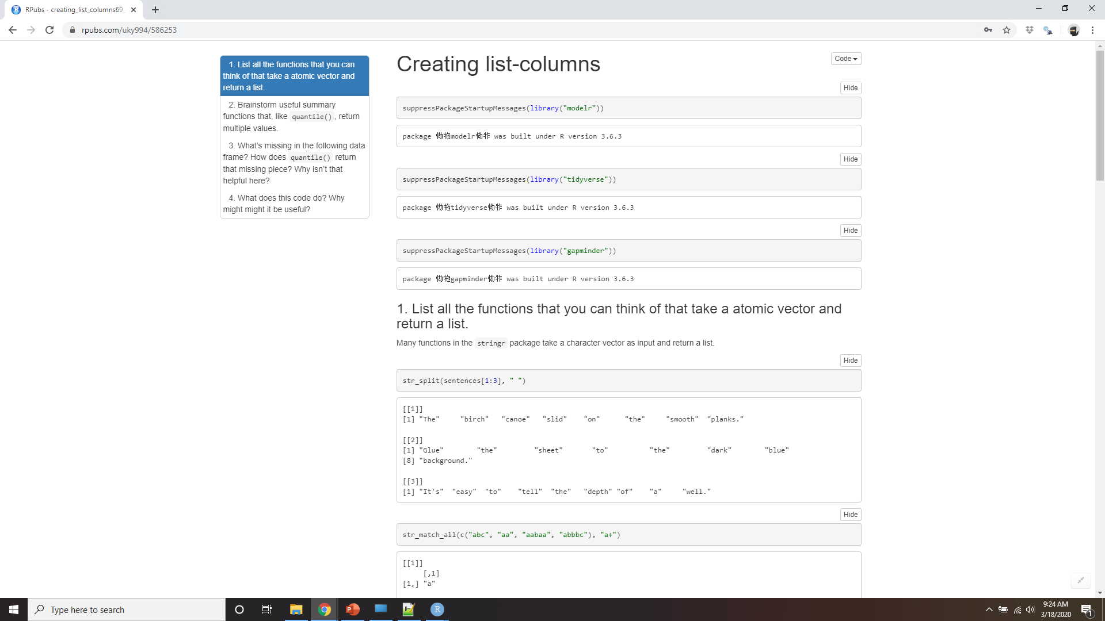
Demo creating list-columns
Notes:
https://rpubs.com/uky994/586253
List all the functions that you can think of that take a atomic vector and return a list.
Brainstorm useful summary functions that, like quantile(), return multiple values.
What’s missing in the following data frame? How does quantile() return that missing piece? Why isn’t that helpful here?
mtcars %>% group_by(cyl) %>% summarise(q = list(quantile(mpg))) %>% unnest() #> Warning: `cols` is now required. #> Please use `cols = c(q)` #> # A tibble: 15 x 2 #> cyl q #> <dbl> <dbl> #> 1 4 21.4 #> 2 4 22.8 #> 3 4 26 #> 4 4 30.4 #> 5 4 33.9 #> 6 6 17.8 #> # … with 9 more rows
What does this code do? Why might might it be useful?
mtcars %>% group_by(cyl) %>% summarise_each(funs(list))

Slide 39
Simplifying list-columns
If you want a single value, use mutate() with map_lgl(), map_int(), map_dbl(), and map_chr() to create an atomic vector.
If you want many values, use unnest() to convert list-columns back to regular columns, repeating the rows as many times as necessary.
Notes:
To apply the techniques of data manipulation and visualisation you’ve learned in this book, you’ll need to simplify the list-column back to a regular column (an atomic vector), or set of columns. The technique you’ll use to collapse back down to a simpler structure depends on whether you want a single value per element, or multiple values:
If you want a single value, use mutate() with map_lgl(), map_int(), map_dbl(), and map_chr() to create an atomic vector.
If you want many values, use unnest() to convert list-columns back to regular columns, repeating the rows as many times as necessary.
These are described in more detail below.

Slide 40
List to vector
df <- tribble(
~x,
letters[1:5],
1:3,
runif(5)
)
df %>% mutate( type = map_chr(x, typeof), length = map_int(x, length)
)
#> # A tibble: 3 x 3
#> x type length
#> <list> <chr> <int>
#> 1 <chr [5]> character 5
#> 2 <int [3]> integer 3
#> 3 <dbl [5]> double 5
Notes:
If you can reduce your list column to an atomic vector then it will be a regular column. For example, you can always summarise an object with its type and length, so this code will work regardless of what sort of list-column you have:
This is the same basic information that you get from the default tbl print method, but now you can use it for filtering. This is a useful technique if you have a heterogeneous list, and want to filter out the parts aren’t working for you.

Slide 41
map_*()
df <- tribble(
~x,
list(a = 1, b = 2),
list(a = 2, c = 4)
)
df %>% mutate(
a = map_dbl(x, "a"),
b = map_dbl(x, "b", .null = NA_real_)
)
#> # A tibble: 2 x 3
#> x a b
#> <list> <dbl> <dbl>
#> 1 <named list [2]> 1 2
#> 2 <named list [2]> 2 NA
Notes:
Don’t forget about the map_*() shortcuts - you can use map_chr(x, "apple") to extract the string stored in apple for each element of x. This is useful for pulling apart nested lists into regular columns. Use the .null argument to provide a value to use if the element is missing (instead of returning NULL):

Slide 42
Unnesting
tibble(x = 1:2, y = list(1:4, 1)) %>% unnest(y)
#> # A tibble: 5 x 2
#> x y
#> <int> <dbl>
#> 1 1 1
#> 2 1 2
#> 3 1 3
#> 4 1 4
#> 5 2 1
Notes:
unnest() works by repeating the regular columns once for each element of the list-column. For example, in the following very simple example we repeat the first row 4 times (because there the first element of y has length four), and the second row once:

Slide 43
# Ok, because y and z have the same number of elements in
# every row
df1 <- tribble(
~x, ~y, ~z,
1, c("a", "b"), 1:2,
2, "c", 3
)
df1
#> # A tibble: 2 x 3
#> x y z
#> <dbl> <list> <list>
#> 1 1 <chr [2]> <int [2]>
#> 2 2 <chr [1]> <dbl [1]>
Notes:
This means that you can’t simultaneously unnest two columns that contain different number of elements:

Slide 44
df1 %>% unnest(y, z)
#> Warning: unnest() has a new interface. See ?unnest for details.
#> Try `df %>% unnest(c(y, z))`, with `mutate()` if needed
#> # A tibble: 3 x 3
#> x y z
#> <dbl> <chr> <dbl>
#> 1 1 a 1
#> 2 1 b 2
#> 3 2 c 3

Slide 45
# Doesn't work because y and z have different number of elements
df2 <- tribble(
~x, ~y, ~z,
1, "a", 1:2,
2, c("b", "c"), 3
)
df2
#> # A tibble: 2 x 3
#> x y z
#> <dbl> <list> <list>
#> 1 1 <chr [1]> <int [2]>
#> 2 2 <chr [2]> <dbl [1]>

Slide 46
df2 %>% unnest(y, z)
#> Warning: unnest() has a new interface. See ?unnest for details.
#> Try `df %>% unnest(c(y, z))`, with `mutate()` if needed
#> # A tibble: 4 x 3
#> x y z
#> <dbl> <chr> <dbl>
#> 1 1 a 1
#> 2 1 a 2
#> 3 2 b 3
#> 4 2 c 3
Notes:
The same principle applies when unnesting list-columns of data frames. You can unnest multiple list-cols as long as all the data frames in each row have the same number of rows.

Slide 47

Demo Simplifying list-columns
Notes:
https://rpubs.com/uky994/586281
Why might the lengths() function be useful for creating atomic vector columns from list-columns?
List the most common types of vector found in a data frame. What makes lists different?

Slide 48
Making tidy data with broom
broom::glance(model) returns a row for each model.
broom::tidy(model) returns a row for each coefficient in the model.
broom::augment(model, data) returns a row for each row in data, adding extra values like residuals, and influence statistics.
Notes:
The broom package provides three general tools for turning models into tidy data frames:
broom::glance(model) returns a row for each model. Each column gives a model summary: either a measure of model quality, or complexity, or a combination of the two.
broom::tidy(model) returns a row for each coefficient in the model. Each column gives information about the estimate or its variability.
broom::augment(model, data) returns a row for each row in data, adding extra values like residuals, and influence statistics.

